Slide 1

Anvisys Technology Pvt. Ltd
Your Trusted IT Solution and Consulting Partner
Office address: 63 Noida,Uttar Pradesh, H Block,Sector
www.Anvisys.online
Number: 9591033223

Slide 2
Our Mission
We aim to be the most preferred IT partner to our clients by helping the achieve their goals
We focus on our client’s goal & provide the latest technology
Anvisys is about providing a platform to our team members to learn & grow.

Slide 3
Problem Solving Solution
data maintenance & analysing
Upgrade & Maintenance
Technical Support
THINK
BIGGER
Solve various problems like database-management coding developing & testing
Efficient backend support
Steady Growth
Working in integration with all the levels of your

Slide 4
WE AIM TO MAINTAIN A LONG TERM RELATION WITH OUR CLIENTS
End to End Software Solutions
Android , Desktop, Web, DB
Staffing – Software Professionals
Services
Geographical Information System(GIS
Software Testing
Notes:
Types of services we offer

Slide 5
Xml for UI, Core Java for Business Logic, API or services to read/write data Android Studio : Native Android Development tool
Android Application
1
Html
CSS
Java Script
Web Application
2
Word press Angular JS
Angular 4.0
ASP.net
Desktop Application
3
MYSQL
Mongo DB
SQLServer
Database Designing
4
Notes:
What we do ?

Slide 6
Result web service
Small size solutions of team of 5 to 10 resources:
Web Application
Database Designing
Android Application
Microservices and Service
Non Functional
Architecture: Monolithic, Service Oriented Architecture, Microservice Architecture
Security: Database level, OAuth, SSL, Cloud Security
Methodology : Agile, Waterfall, iterative
Web service
Client
HTTP request
JSON/XML
Device
Web Apps Desktop
Database

Slide 7
Software Solutions we Offer
Desktop Application
Android Application
Database Designing
Web Application

Slide 8







We area of expertise
Support area’s
Notes:
The content is to be added .kindly review it

Slide 9
Our Clients
Egis India.
Pinnacle Geo-system
Dr. Sundeep Goyal
BHEL, Haridwar
Advisory On Demand
Nestin

Slide 10


PRODUCT 3
PRODUCT 2
NESTIN
PRODUCT 2
X- PEN
PRODUCT 1
PRODUCT 1
Society Management System
Car pooling
Security for society
Vendor management
Let’s Catch-up
Expense and Accounting Management
Projects Sale, purchase entries by Project Manager
3
Share your location with your friends
Share your location with your friends
Receive location shared by your friends
Get the Route, Location and Time Difference
Receive location shared by your friends
Our products
2
1

Slide 11

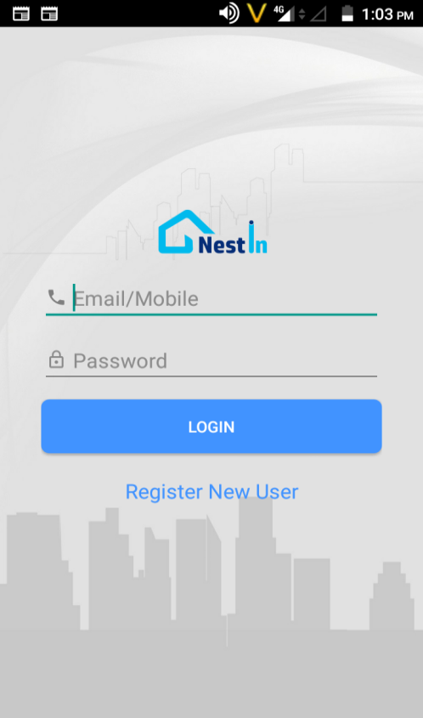
A Complete Society Management System

Slide 12
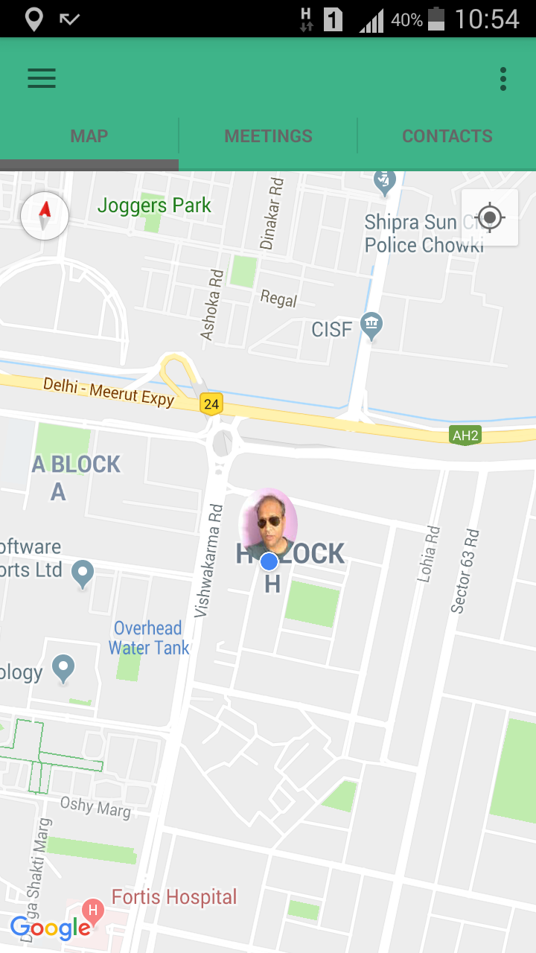
Let’s Catch-up
Share your location with your friends
Receive location shared by your friends
.
Get the Route, Location and Time Difference
Notes:
Now track your close ones by Let’s catch-up. With live tracking and location sharing .

Slide 13
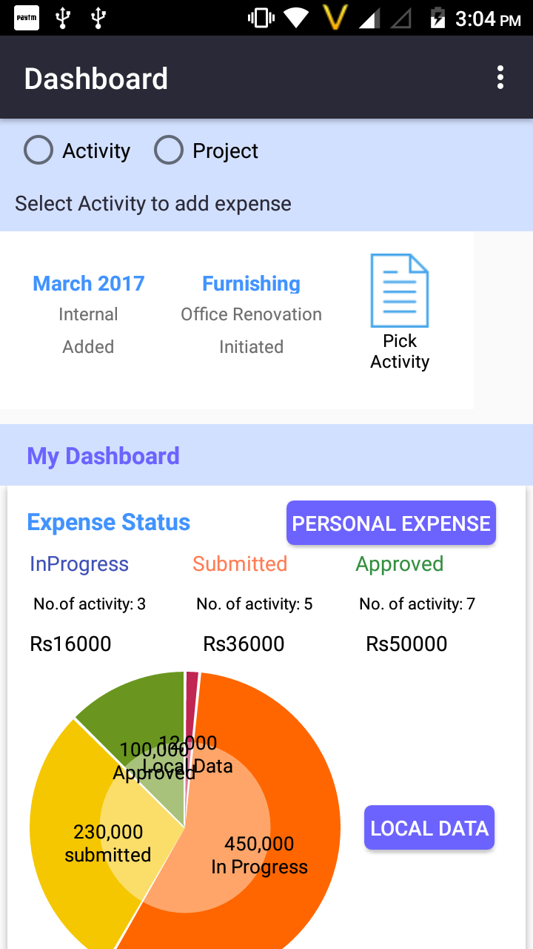
+150%
X- PEN
17,987
9,9871
Expense and Accounting Management for personal and organization needs
+120%
+110%
-50%
5,9871
7,9871
-30%
Projects Sale, purchase entries by Project Manager
Salary, Capex and other transaction by Accounts
3,9871

Slide 15
Anvisys Technology Pvt. Ltd
Your Trusted IT Solution and Consulting Partner
Office address: 63 Noida,Uttar Pradesh, H Block,Sector
www.Anvisys.online
Number: 9591033223

Slide 16
Our Mission
We aim to be the most preferred IT partner to our clients by helping the achieve their goals
We focus on our client’s goal & provide the latest technology
Anvisys is about providing a platform to our team members to learn & grow.

Slide 17
Problem Solving Solution
data maintenance & analysing
Upgrade & Maintenance
Technical Support
THINK
BIGGER
Solve various problems like database-management coding developing & testing
Efficient backend support
Steady Growth
Working in integration with all the levels of your

Slide 18
WE AIM TO MAINTAIN A LONG TERM RELATION WITH OUR CLIENTS
End to End Software Solutions
Android , Desktop, Web, DB
Staffing – Software Professionals
Services
Geographical Information System(GIS
Software Testing
Notes:
Types of services we offer

Slide 19
Xml for UI, Core Java for Business Logic, API or services to read/write data Android Studio : Native Android Development tool
Android Application
1
Html
CSS
Java Script
Web Application
2
Word press Angular JS
Angular 4.0
ASP.net
Desktop Application
3
MYSQL
Mongo DB
SQLServer
Database Designing
4
Notes:
What we do ?

Slide 20
Result web service
Small size solutions of team of 5 to 10 resources:
Web Application
Database Designing
Android Application
Microservices and Service
Non Functional
Architecture: Monolithic, Service Oriented Architecture, Microservice Architecture
Security: Database level, OAuth, SSL, Cloud Security
Methodology : Agile, Waterfall, iterative
Web service
Client
HTTP request
JSON/XML
Device
Web Apps Desktop
Database

Slide 21
Software Solutions we Offer
Desktop Application
Android Application
Database Designing
Web Application

Slide 22
We area of expertise
Support area’s
Notes:
The content is to be added .kindly review it

Slide 23
Our Clients
Egis India.
Pinnacle Geo-system
Dr. Sundeep Goyal
BHEL, Haridwar
Advisory On Demand
Nestin

Slide 24
PRODUCT 3
PRODUCT 2
NESTIN
PRODUCT 2
X- PEN
PRODUCT 1
PRODUCT 1
Society Management System
Car pooling
Security for society
Vendor management
Let’s Catch-up
Expense and Accounting Management
Projects Sale, purchase entries by Project Manager
3
Share your location with your friends
Share your location with your friends
Receive location shared by your friends
Get the Route, Location and Time Difference
Receive location shared by your friends
Our products
2
1

Slide 25
A Complete Society Management System

Slide 26
Let’s Catch-up
Share your location with your friends
Receive location shared by your friends
.
Get the Route, Location and Time Difference
Notes:
Now track your close ones by Let’s catch-up. With live tracking and location sharing .

Slide 27
+150%
X- PEN
17,987
9,9871
Expense and Accounting Management for personal and organization needs
+120%
+110%
-50%
5,9871
7,9871
-30%
Projects Sale, purchase entries by Project Manager
Salary, Capex and other transaction by Accounts
3,9871

